Slide 1
Machine Learning Decision Trees
IIIT Sri City

Slide 2
Impurity
Several different mathematical measures of impurity have been proposed, all of which have basically the same behaviour.
Entropy Impurity
Variance Impurity
Gini Impurity
Misclassification impurity

Slide 3
Entropy Impurity
Let i(N) denote the impurity of a node N. In all cases, we want i(N) to be 0 if all of the patterns that reach the node bear the same category label, and to be large if the categories are equally represented.
The most popular measure is the entropy impurity (information impurity).
Entropy: A measure of “randomness” or “unpredictability.
In information theory, the number of bits that are needed to code the transmission.
Credits: Machine Learning, UCSB

Slide 4

Entropy Impurity
where P(ωj) is the fraction of patterns at node N that are in category ωj .∗
By the well-known properties of entropy, if all the patterns are of the same category, the impurity is 0; otherwise it is positive, with the greatest value occurring when the different classes are equally likely.
Credits: Machine Learning, UCSB

Slide 5
variance impurity
Another definition of impurity is particularly useful in the two-category case.
Given the desire to have zero impurity when the node represents only patterns of a single category, the simplest polynomial form is:
i(N) = P(ω1)P(ω2)
It is is related to the variance of a distribution associated with the two categories.
Credits: Machine Learning, UCSB

Slide 6

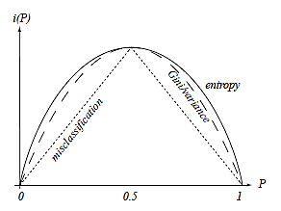
Gini impurity
A generalization of the variance impurity, applicable to two or more categories, is the Gini impurity:
This is just the expected error rate at node N if the category label is selected randomly from the class distribution present at N.
This criterion is more strongly peaked at equal probabilities than is the entropy impurity.
Credits: Machine Learning, UCSB

Slide 7
Misclassification impurity
It measures the minimum probability that a training pattern would be misclassified at N.
this measure is the most strongly peaked at equal probabilities.
We now come to the key question — given a partial tree down to node N, what value s should we choose for the property test T?
Credits: Pattern Classification, Duda Hart

Slide 8
Finding an optimal decision for a node.
The drop in impurity is defined by
where N_{L} and N_{R} are the left and right descendent nodes, i(N_{L}) a nd i(N_{R}) their impurities, and P_{L} is the fraction of patterns at node N that will go to N_{L} when property test T is used.
Then the “best” test value s is the choice for T that maximizes
Δi(T).
If the form of the decisions is based on the nominal attributes, we may have to perform extensive or exhaustive search over all possible subsets of the training set to find the rule maximizing Δi.
If the attributes are real-valued, one could use gradient descent algorithms to find a splitting hyperplane giving a polythetic tree.
Credits: Machine Learning, UCSB

Slide 9
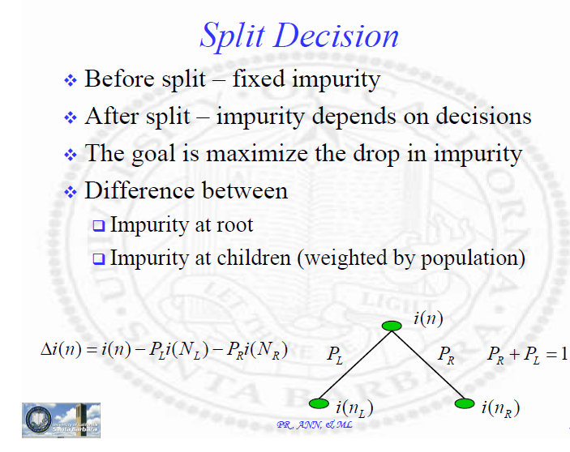
Credits: Machine Learning, UCSB

Slide 10
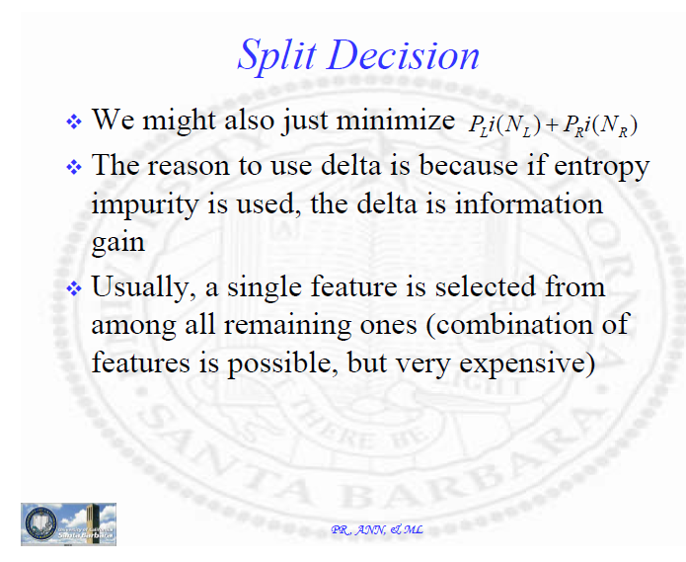
Credits: Machine Learning, UCSB

Slide 11
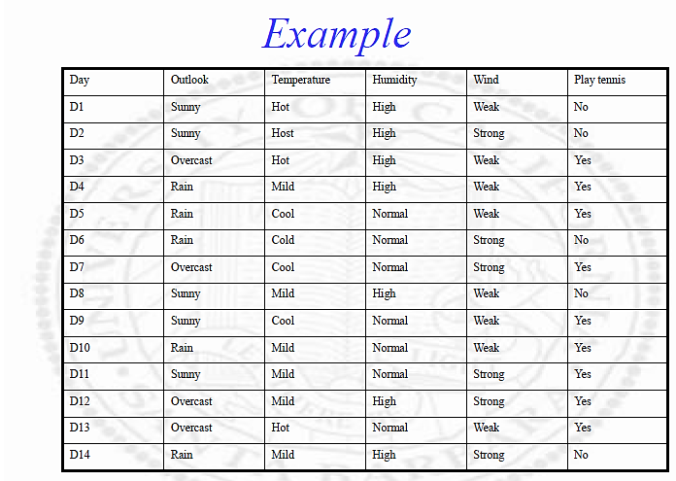
Credits: Machine Learning, UCSB

Slide 12
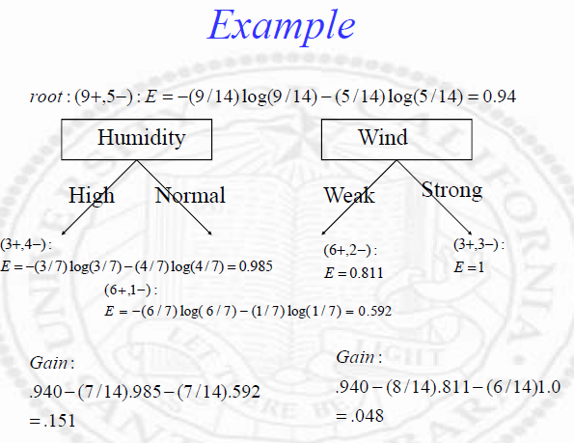
Credits: Machine Learning, UCSB

Slide 13
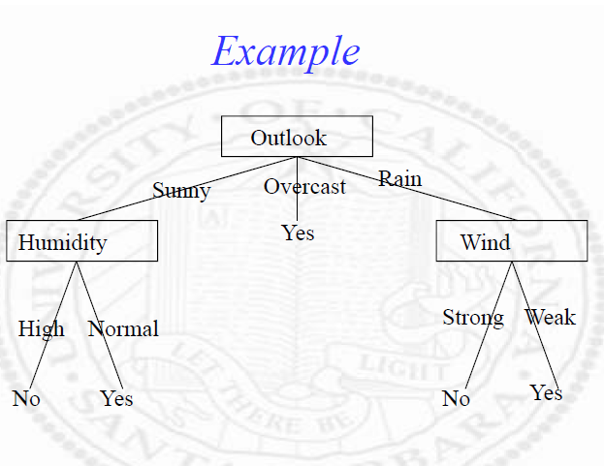
Credits: Machine Learning, UCSB

Slide 14

Multiway Splits
In general, more splits allow impurity to drop
Splits reduce the samples in each branch
With few samples, it is likely that one sample might dominate (1 sample, impurity=0, 2 samples, 50% chance impurity=0)
Proper scaling of change of impurity
Large split is penalized
Larger the entropy -> bad split
Credits: Pattern Classification, Duda hart

